Slide 1
NEW TIGERS CONSULTING
-- Mining Programme

Slide 2
ABOUT NTC
Founded in 1997, New Tigers Consulting and its wholly owned Chinese subsidiary New Tigers Technologies Ltd are focused on high-level proficient service to European and North American companies looking towards China for expansion of their business.
Uniquely placed with offices in China, NTC provides top range infrastructure, technological flexibility and cost effective resources to assist companies in achieving their growth potentials for their development. All services are tailor made to facilitate long-term, outstanding success for its clients, whether they are entering the market or looking for new growth strategies. Altogether, NTC has successfully served more than 1,400 International firms in the past 22 years.
New Tigers Consulting

Slide 3
COMPANY MILESTONE
Set up a consulting company in Dublin, Ireland
Set up offices in Shanghai, Beijing, Shenzhen and Brisbane, Australia
Start to provide Mining financing & offtake service
2002
2005
2008
1997
2004
2007
NTC was established in Canada
Set up its China HQ in Suzhou — New Tigers Technologies (SIP) Co., Ltd
Setup offices in Hong Kong and Rochester, New York

Slide 4
MINING PROGRAMME
Specifically on the mining business front, with the upsurge of the Chinese economy, Chinese companies and investment firms have discovered a new opportunity in the mining space, and are willing and ready to invest in promising overseas projects. However, closing financing deals between foreign mining companies and Chinese Investors are not always easy due to differences in language, culture, legal system and expectations. Prolonged negotiations plus extensive travels to China add to the cost of doing business.
Over the past 12 years, NTC worked with more than 70 foreign junior and producing mining companies and represented them in China to secure offtake partners and investors. To match the recent requirements from our Mining Clients, NTC has now launched our unique “Mining Programme”.
www.newtigers.com

Slide 5
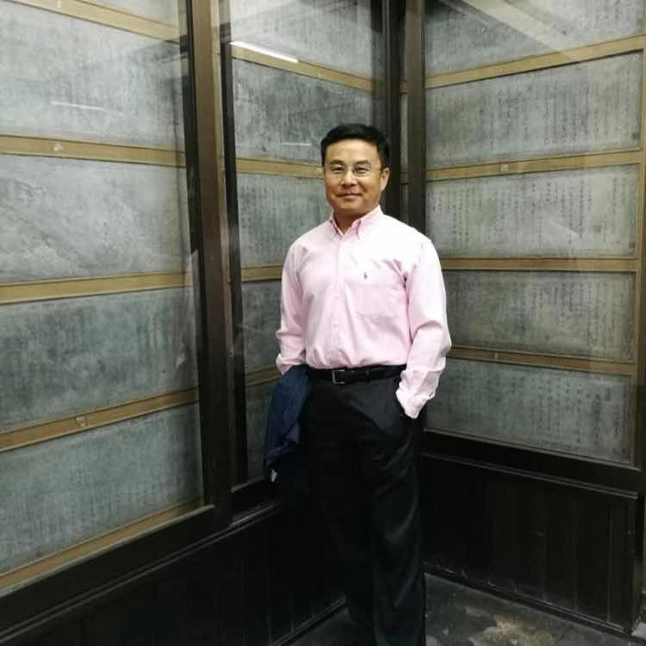
NTC MINING PROGRAMME
TEAM LEADER
Dr. Wei Qian, a Canadian citizen, born in Suzhou, China, is the Manager Director of New Tigers Consulting Ltd (Canada) and New Tigers Technologies (SIP) Co., Ltd. He is also the major shareholder of New Tigers Investment Ltd (Ireland). He obtained a Master’s Degree in Business Studies and the award of Sir Charles Harvey at London School of Economics (LSE) in 1991, and received a Doctor’s Degree in Economics at the University of Limerick, Ireland in 1999.
Dr. Wei Qian
Managing Director

Slide 6
NTC MINING PROGRAMME
OUR SERVICES
Represent your company and project in China cost effectively
Seek and secure financing from Chinese investor/partners
Search, secure and manage offtake customers

Slide 7
NTC MINING PROGRAMME
OUR SERVICES
Translation and Filing
Meeting Arrangements
Local Presence/Liaison
Project Advisory
NTC will provide accurate translation service for the Mining Project written materials and finalize with readable Chinese project files to the potential investors.
NTC will research and compile a database of potential partners according to client’s requirement; then conference calls/ meetings/roadshows would be organized and hosted.
NTC will participate as project representative in trade shows and conferences locally in China, also for the communication/coordination/relations maintenance with Chinese investors/partners.
NTC will review the project process and assist in addressing any questions, concerns or other requirements at the local level in China, also provide regular reporting to secure the project progress.
Chinese Project File
Investor Database
Project China Office
Professional Consultant

Slide 8
NTC MINING PROGRAMME
Service Processing
01
02
03
04
Understand the Project
Meeting arrangements
Project communication
Close the project and after service
During the project meeting and written material translation, NTC will have an overall understanding of the project then compile a list for potential partners from NTC’s database.
NTC will act as the project China representative, arrange and participate roadshows, conference calls for clients to present the project and discuss the cooperation potentials.
NTC will follow up the project process, assist solve issues and queries at local level. Regular report would be submit to the project to inform the recent progress or problems if occurs.
NTC will participate project negotiation between client and its partner, making appropriate suggestion/recommendation to lower down the risk and secure “Win-Win” situation when needed.

Slide 9
Our Advantage
Business Resources Share
Cost effectively
NTC can share its own database of over 800 companies in Chinese Mining, Exploration and Production Industries and mining investment firms.
Engaged as local representative, NTC can save your time and cost from prolonged negotiations plus extensive travels.
NTC MINING PROGRAMME
NTC will act as a liaison for Western companies who wish to do business with China-based entities in areas ranging from, but not limited to, EPC agreements, project financing and related structuring, joint ventures, commodity off-take agreements and the establishment of manufacturing facilities.
Team Service
Bi-lingual work
By a bilingual worked team, NTC has saved at least 1/2 time consuming for the communication and coordination with our customer and its clients
Not only for a local rep, You have also hired a profession team for translation, logistics, business operation, legal compliance, admin, accounting, etc. with a high work efficiency.

Slide 10
“Capitalize on our capabilities and resources in China and western countries, NTC adds value to both overseas mining companies and Chinese Investor/Buyer/Partner. ”
NTC MINING PROGRAMME

Slide 11
Generation Mining
NTC MINING PROGRAMME
OUR CLIENT
(for on-going projects in 2020)

Slide 12
NTC MINING PROGRAMME
OUR LONG-TERM PARTNER
(Database over 800 Chinese Mining relevant Companies)
Beijing General Research Institute of Mining &Metallurgy
China Minmetals Corporation
China Nonferrous Metal Industry’s Foreign Engineering and Construction Co., LTD
Zijin Mining
BYD Energy
CATL Battery

Slide 13
NTC MINING PROGRAMME
OUR CONTACT
Dr. Wei Qian
Managing Director
Tel: +86 186 2628 7856
E-mail: wqian@newtigers.com.cn

Slide 14
T H A N K S
FOR WATCHING

